Slide 1
COST
Statistical Estimation Theory

Slide 2
Revision
Hypothesis- claim or educated guess about a population.
Ho – Null Hypothesis- formulated for the purpose of rejecting or nullifying it.
H1 – Alternat Hypothesis- believe to be true or hope to prove true.
Hypothesis Testing- Whether to accept or reject Ho

Slide 3
Type I and Type II Errors
Type I Error
When we reject a hypothesis when it should be accepted.
Rejecting TRUE hypothesis
Type II Error
When we accept a hypothesis when it should be rejected
Accepting FALSE hypothesis

Slide 4
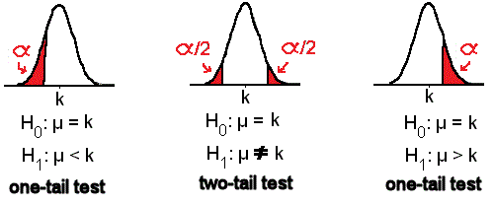
Two Tailed and One Tailed Test

Slide 5
Two Tailed and One Tailed Test
One-tailed tests
Is our finding significantly greater than our assumed value?
Is our finding significantly less than our assumed value?
Two-tailed tests
Are the findings different from the assumed mean?

Slide 6
Level of Significance
Maximum allowable probability of making type I error.
This probability is denoted by 𝛼
A significance level of 0.05 (5%) 𝑜𝑟 0.01 (1%) is common.

Slide 7
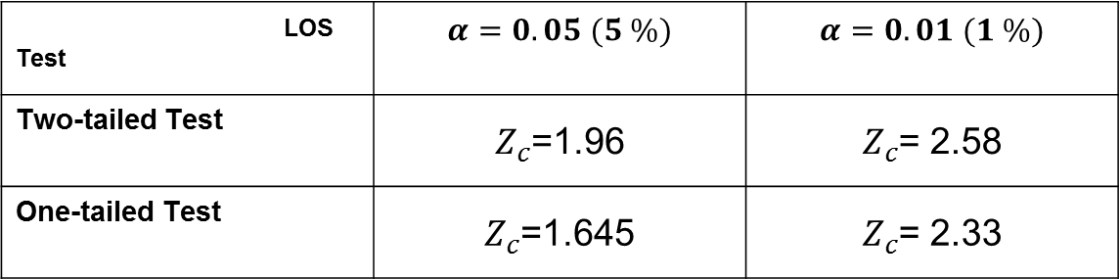

Critical Value $Z_{c}$
LOS Test | $$α=0.05 (5 \%)$$ | $$α=0.01 (1 \%)$$
Two-tailed Test | $Z_{c}$=1.96 | $Z_{c}$= 2.58
One-tailed Test | $Z_{c}$=1.645 | $Z_{c}$= 2.33

Slide 8

Z Score
Mean
$$Z=\frac{\overline{X}−μ}{\frac{σ}{\sqrt{N}}}$$
Proportion
$$Z=\frac{P −p}{\sqrt{\frac{pq}{N}}}$$

Slide 9

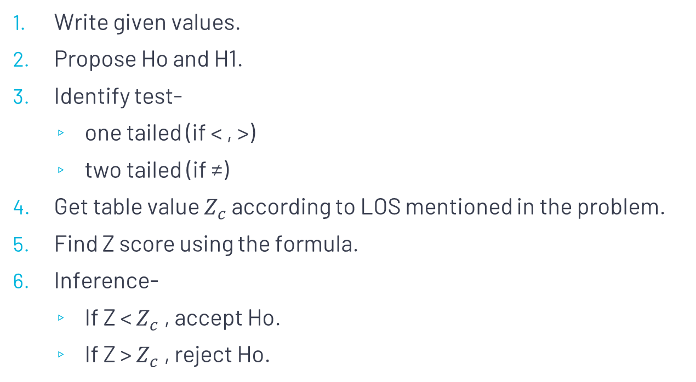

Steps for hypothesis testing
Write given values.
Propose Ho and H1.
Identify test-
one tailed (if < , >)
two tailed (if ≠)
Get table value $Z_{c}$ according to LOS mentioned in the problem.
Find Z score using the formula.
Inference-
If Z < $Z_{c}$ , accept Ho.
If Z > $Z_{c}$ , reject Ho.
Reject Ho
Accept Ho
Reject Ho
$$Z_{c}$$
$$Z_{c}$$

Slide 10
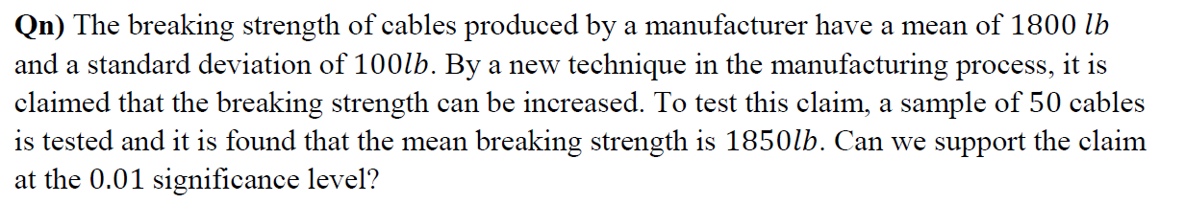
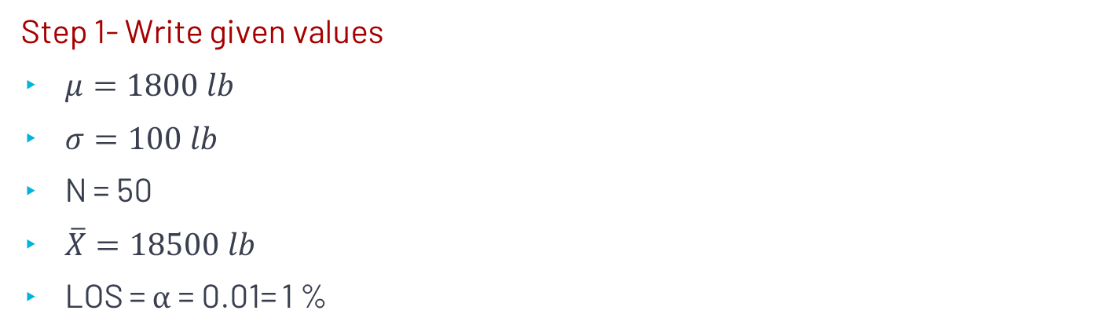
Question
Step 1- Write given values
$μ=1800 lb$
$σ=100 lb$
N = 50
$\overline{X}=18500 lb$
LOS = $α$= 0.01= 1 %
Population Parameter
Sample data

Slide 11
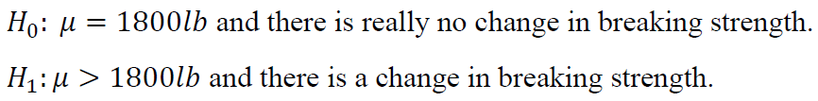
Cont..
Step 2- Propose H0
Step 3- Identify Test
As > sign is there, use One tailed Test

Slide 12
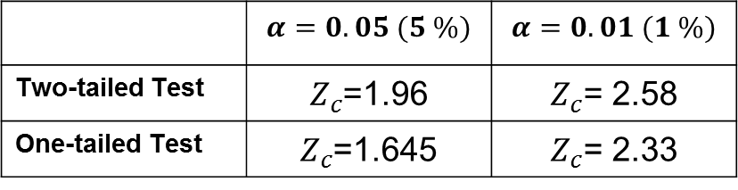
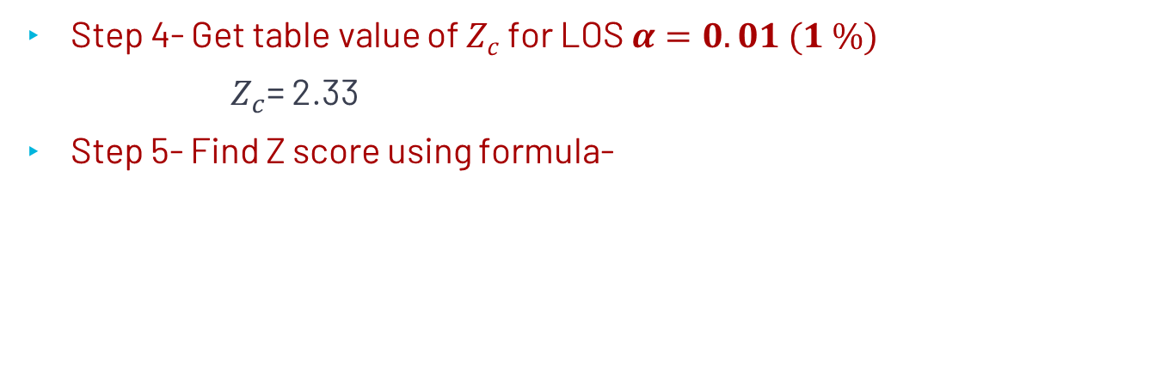

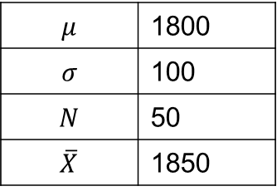

Cont.…
 | $$α=0.05 (5 \%)$$ | $$α=0.01 (1 \%)$$
Two-tailed Test | $Z_{c}$=1.96 | $Z_{c}$= 2.58
One-tailed Test | $Z_{c}$=1.645 | $Z_{c}$= 2.33
Step 4- Get table value of $Z_{c}$ for LOS $α=0.01 (1 \%)$
$Z_{c}$= 2.33
Step 5- Find Z score using formula-
$$μ$$ | 1800
$$σ$$ | 100
$$N$$ | 50
$$\overline{X}$$ | 1850
$$Z=\frac{\overline{X}−μ}{\frac{σ}{\sqrt{N}}}$$
$Z=$3.5355

Slide 13
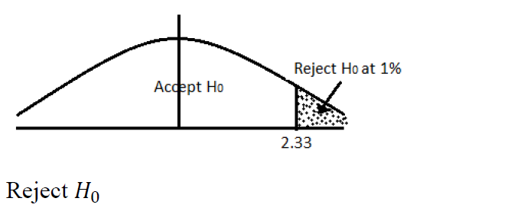
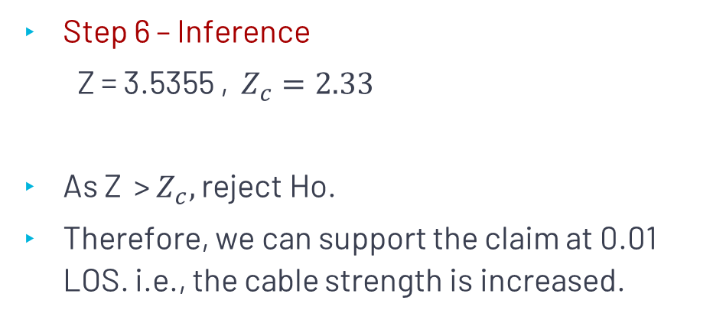
Cont. ..
Step 6 – Inference
$\text{Z}\text{ = }\text{3.5355 , }Z_{c}=2.33$
As Z $\text{> }Z_{c},$reject Ho.
Therefore, we can support the claim at 0.01 LOS. i.e., the cable strength is increased.

Slide 14
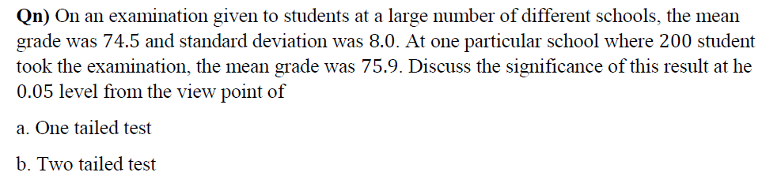
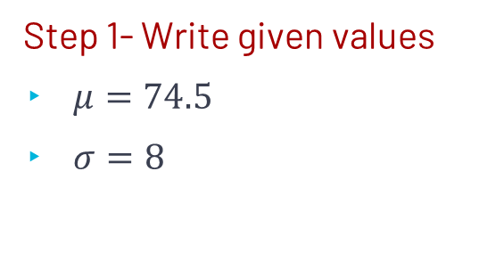
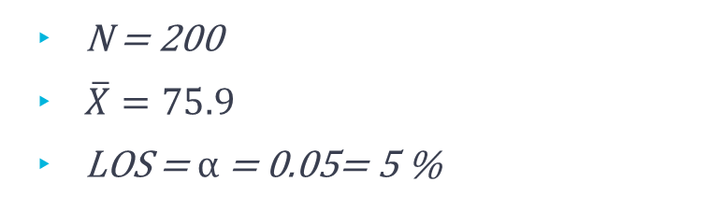
Question
Step 1- Write given values
$μ=74.5$
$σ=8$
N = 200
$\overline{X}=75.9$
LOS = $α$= 0.05= 5 %

Slide 15
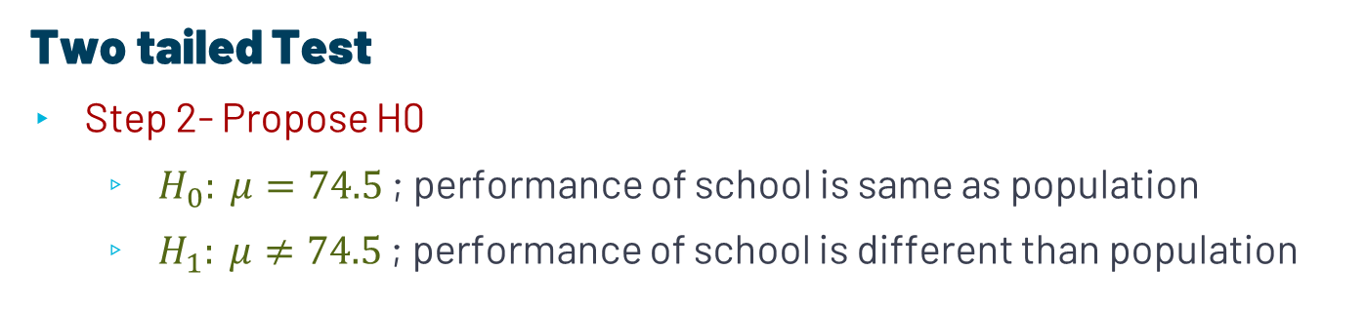
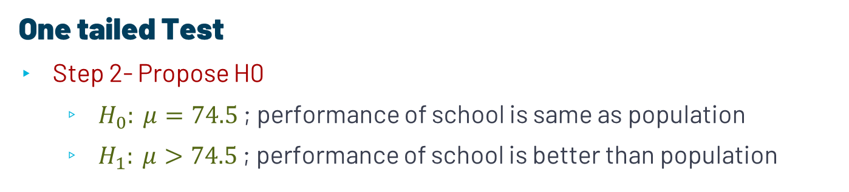
Cont..
One tailed Test
Step 2- Propose H0
$H_{0}: μ=74.5$ ; performance of school is same as population
$H_{1}: μ>74.5$ ; performance of school is better than population
Two tailed Test
Step 2- Propose H0
$H_{0}: μ=74.5$ ; performance of school is same as population
$H_{1}: μ≠74.5$ ; performance of school is different than population

Slide 16
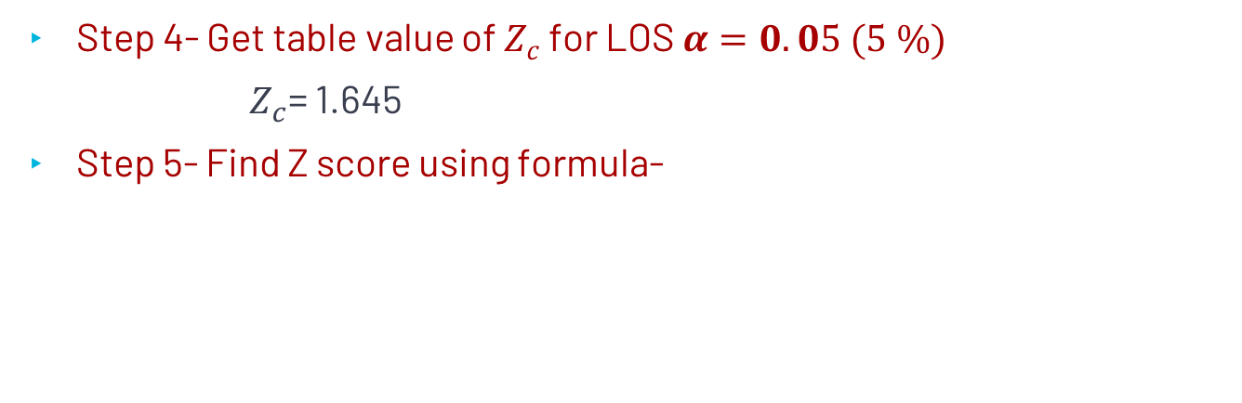

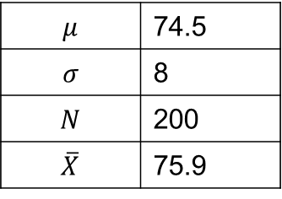
Cont.…
 | $$α=0.05 (5 \%)$$ | $$α=0.01 (1 \%)$$
Two-tailed Test | $Z_{c}$=1.96 | $Z_{c}$= 2.58
One-tailed Test | $Z_{c}$=1.645 | $Z_{c}$= 2.33
One tailed Test
Step 4- Get table value of $Z_{c}$ for LOS $α=0.05 (5 \%)$
$Z_{c}$= 1.645
Step 5- Find Z score using formula-
$$μ$$ | 74.5
$$σ$$ | 8
$$N$$ | 200
$$\overline{X}$$ | 75.9
$$Z=\frac{\overline{X}−μ}{\frac{σ}{\sqrt{N}}}$$
$Z=$2.4748

Slide 17
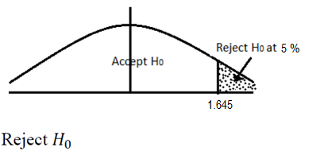
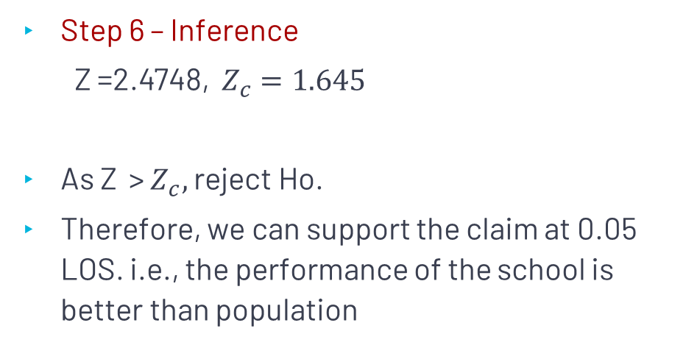
Cont. ..
Step 6 – Inference
$\text{Z}\text{ =2}\text{.4748, } Z_{c}=1.645$
As Z $\text{> }Z_{c},$reject Ho.
Therefore, we can support the claim at 0.05 LOS. i.e., the performance of the school is better than population

Slide 18
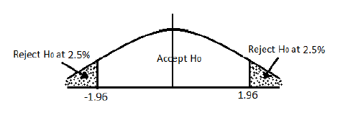
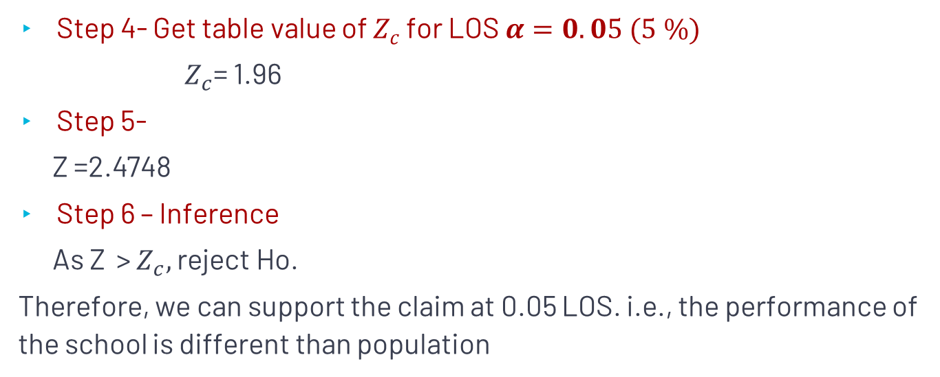
Cont.…
 | $$α=0.05 (5 \%)$$ | $$α=0.01 (1 \%)$$
Two-tailed Test | $Z_{c}$=1.96 | $Z_{c}$= 2.58
One-tailed Test | $Z_{c}$=1.645 | $Z_{c}$= 2.33
Two tailed Test
Step 4- Get table value of $Z_{c}$ for LOS $α=0.05 (5 \%)$
$Z_{c}$= 1.96
Step 5-
$\text{Z}\text{ =2.4748}$
Step 6 – Inference
As Z $\text{> }Z_{c},$reject Ho.
Therefore, we can support the claim at 0.05 LOS. i.e., the performance of the school is different than population

